Slide 1
STAT 553 Research Project: Depression, Anxiety, and Stress
Bernal, I., Del Carpio Bellido Vargas, L., Hermosillo, B. & Yang, C. (2023)

Slide 2

Research Problem
High levels of anxiety, depression, and stress are signs of poor mental health and low well-being.
Few studies have used machine learning tools and techniques to explore the relationship between these factors as well as other significant independent variables.

Slide 3
Literature Review
High levels of anxiety, depression, and stress are signs of poor mental health can have adverse effects on other aspects of an individual’s life (Beiter et al., 2014).
Depression can immobilize individuals making it difficult to maintain themselves, their family and friends, and be productive in their work or school (Holden, 2000). Individuals high in depression are also more likely to have poor coping mechanisms tied to alcohol or substance use (Holden, 2000).
High levels of anxiety can lead to poor academic performances and social functioning and even panic attacks (Van Amerigan et al., 2003).
Those high in stress are also likely to be negatively impacted in their physical health (e.g. heart disease, poor immunity) and cognition, such as difficulty with memory and learning (Yaribeygi et al., 2017)

Slide 4
Literature Review
The Depression, Anxiety, and Stress Scale (DASS) is a 42-item questionnaire that attempts to measure these latent constructs using observed variables.
Many of the questions are tied to low mood, physiological arousal, and tension/irritability (Parkinity & Mcauley, 2010).
While many studies exploring this scale have been conducted, most have used traditional statistical methods (e.g., correlationS, OLS Regression, etc.) though new studies using machine learning approaches are beginning to emerge.
The purpose of this project was to build on this movement and implement machine learning tools and techniques to explore and identify any significant relationships or findings between these three variables and independent demographic variables.

Slide 5
Data Source
For this research project we looked at data collected for the Depression Anxiety and Stress Scales (DASS)
Obtained from Open-Source Psychometrics Project: http://openpsychometrics.org/_rawdata/
Per the code book, data was collected between 2017-2019
Consisted of 39,775 records.
DASS consists of 42 questions on a 4-point likert Scale
1 = Did not apply to me at all
2 = Applied to me to some degree, or some of the time
3 = Applied to me to a considerable degree, or a good part of the time
4 = Applied to me very much, or most of the time.
Subscales
Depression: 14 questions (Q3, 5, 10, 13, 16, 17, 21, 24, 26, 31, 34, 37, 38, 42),
E.g., I couldn't seem to experience any positive feeling at all.
Anxiety: 14 questions (Q2 4 7 9 15 19 20 23 25 28 30 36 40 41).
E.g., I found myself in situations that made me so anxious I was most relieved when they ended.
Stress: 14 questions (Q1, 6, 8, 11, 12, 14, 18, 22, 27, 29, 32, 33, 35, 39).
E.g., I found myself getting upset by quite trivial things.
Assignments were based on previous literature.

Slide 6
Overview of DASS Dimensions
Depression
Anxiety
Stress
Self-disparaging
convinced that life has no meaning or value
unable to experience enjoyment or satisfaction
apprehensive, panicky
trembly, shaky
aware of dryness of the mouth, sweaty palms
worried about performance and possible loss of control
over-aroused, tense
unable to relax
touchy, easily upset
irritable
intolerant of interruption or delay
Lovibond, P.F. & Lovibond, S.H. (1995)
Notes:
Here is an overview of the DASS dimensions.
These are Characteristics < CLICK > of high scorers on each dimension < CLICK > and a few descriptions for each dimension are included < CLICK >
Depression scale: < CLICK >
Self-disparaging
convinced life has no meaning or value
unable to experience enjoyment or satisfaction
Associated with words or ideas that have to do with “self-loathing, sadness, lacking energy, disinterest”
Anxiety scale < CLICK >
apprehensive, panicky
trembly, shaky
sweatiness of the palms
worried about performance and possible loss of control
Associated with words like “worry” “fear” and “panic”
Stress scale < CLICK >
over-aroused, tense
unable to relax
touchy, easily upset
Irritable
intolerant of interruption or delay
Stress has to do with physiological responses, the autonomic nervous system. So words like “irritable, fidgety, tense, intolerant”

Slide 7
16 Validity Check List Items
boat
incoherent
pallid
robot
audible
cuivocal
paucity
epistemology
florted
decide
pastiche
verdid
abysmal
lucid
betray
funny
Answer is….
3 out of 16 were not real words
Cuivocal
Florted
Verdid
Subjects asked to check definitions of words they knew
1 = checked, 0 = not checked
Response of “1” to nonwords were omitted.
Original observations: 39,775
Total Deleted: 5,192
Total Remaining: 34,583
Let’s play a game.
Notes:
This study included 16 validity check items to make sure participants were paying attention and/or answering the questionnaire honestly.
<CLICK > SO.. Let’s play a game! I’m going to quickly show you 16 words and at any point you can write in the chat your guesses or at the end of the list just call it out.
Now, the game is which WORD OR WORDS are not real.
< CLICK THRU WORDS >
The answer? < CLICK >
3 out of the 16 words were not real words. Those words are < CLICK AS YOU SAY THEM >
Cuivocal
Florted
Verdid
< CLICK >
As you may have guessed the subjects were asked to check all words whose definitions they were certain of. < CLICK >
1 = checked, 0 = not checked < CLICK >
Those who responded with a “1” to nonwords were omitted from the final data set. < CLICK >
This dataset originally came with 39,775 observations
After vetting for these validity items, < CLICK >
5,192 observations were deleted (about 13%) - < CLICK >
which left 34,583 observations remaining at this point in the data cleaning process.

Slide 8
Data cleaning
Validity Checklist Items (- 4,554 Obs).
Observations dropped (- 5,192 Obs):
Which categorical values doesn’t match with the codebook.
With country unspecified.
Which age values are greater than 100.
Variables dropped:
Validity checklist.
The Ten Item Personality Inventory.
Variables added:
Country name: Country complete name as described in the ISO 3166 international standard (minor modifications applied)
Has major: If Major variable is not readable or its answer is equivalent to any king of negation (no, none, n/a, etc.), then 0 (No), else 1 (Yes).
Total Deleted:
9,746
Remaining:
30,029

Slide 9
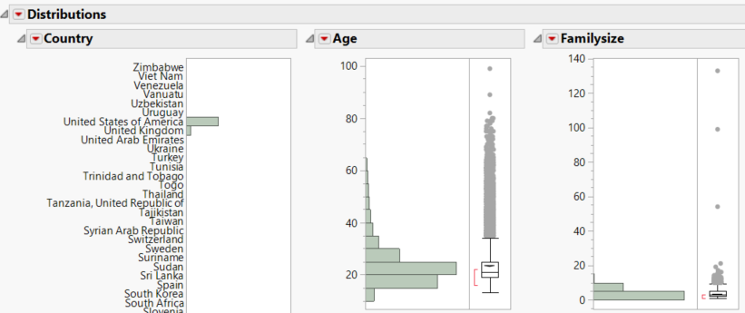
Data cleaning
Data modifications:
Family size: Assuming that respondents missed that the must include themselves when counting the number of children their mother have, the 0 values were updated to 1.
Yes or no variables: Changed from 1 = “Yes” and 2 = “No” to 0 = “No” and 1 - “Yes”.
Rename variables using “Pascal case” standard (eg. MyVariable).
Recode all categorical variables according to the codebook.
Solving issues shown on distribution plots:
Keep countries with >1% of total observations.
Exclude extreme outliers.

Slide 10
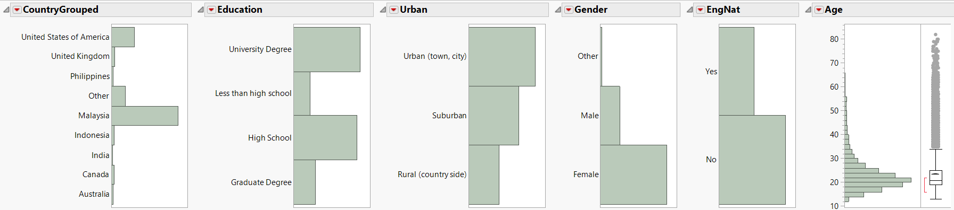
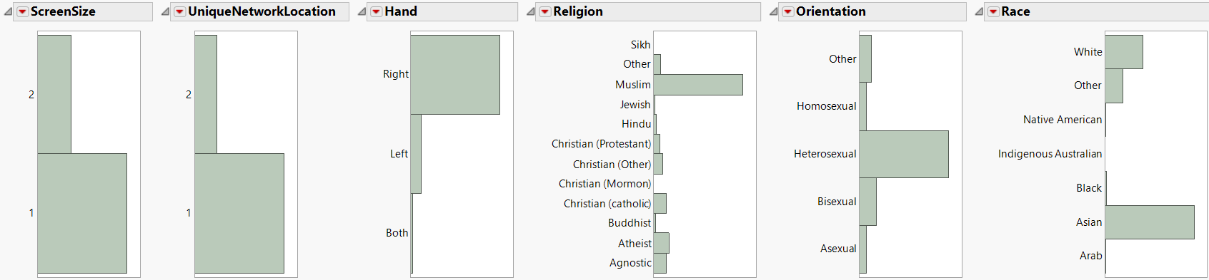
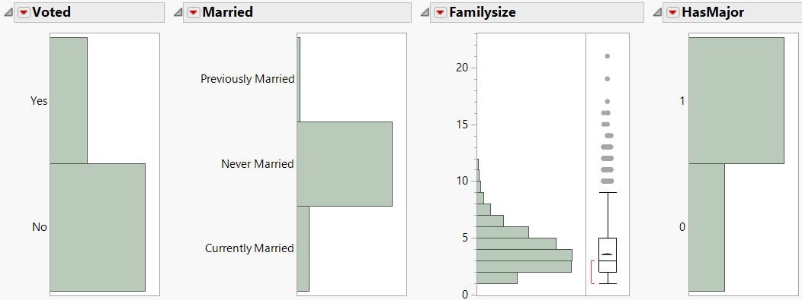
Summary of data distribution
Explore here

Slide 11
Sample Frequencies
After cleaning the data set we were left with a total of 30,029 records.
Majority of participants…
From Malaysia (n=16,771; 55.85%)
Had a University Degree (n=11,849; 39.46%)
Reported Urban (town, city) living (n=13,595; 45.27%)
Identified as female (n=22,920; 76.33%)
English was not their native language (n=19,265; 65.35%)
Were Muslim (n=17,051; 56.78%)
Identified as heterosexual (n=20,069; 66.83%)
Were Asian (n=17,880; 59.54%)
Stated that they had not voted (n=21,576; 71.85%)
Had Never Married (n=25,982; 86.52%)
Reported they had a major (n=21,764; 72.48%)

Slide 12
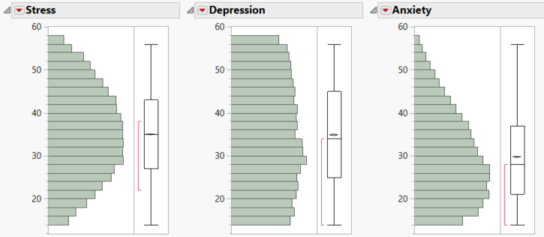
Sample Means
The mean age for participants was 23.44, ranging from 13-99 years old.
The mean family size 3.56, ranging from 1-133 family members (max family size may be entry error).
For our subscales we found:
Depression:
Mean: 34.89
Min: 14
Max: 56
Anxiety;
Mean: 29.75
Min: 14
Max: 56
Stress:
Mean; 34.96
Min: 14
Max: 56

Slide 13
EFA and PCA Studies on DASS
In Yeung’s et al (2020) investigation identified 13 EFAs conducted on the DASS-42 and 24 EFAs on the DASS-21.
Purpose of this study was a systematic review and meta-analysis of DASS.
For DASS-42:
6 run on clinical participants
6 run on non-clinical participants
1 unspecified
For DASS-21:
7 clinical
16 nonclinical
1 mixed sample
The 3-factor model was best-fitting.
There were anomalous factor loadings in the majority of the best-fitting 3-factor models.
From the 37 EFAs that were run, the most frequently reported factor extraction method used was the PCA.
Despite being the most frequently used, Yeung cites that the PCA is not recommended for factor extraction.
Notes:
DASS subscales are meant to represent individual affective states on a spectrum of depression, anxiety, and stress that is based on DIMENSION rather than CATEGORICAL conception.
Standard 3-factor structures were implemented and << CHARLENE READS, BRIAN PRESENTS SCREEN >>
As a group we were interested in understanding what analyses were run for studies that utilized the DASS scale.
In a study by Yeung et alia, the article was a systematic review and meta analytic factor analysis of the DASS scale. The researchers identified 13 Exploratory Factor Analyses conducted on the DASS-42 and 24 EFAs on the DASS-21.
FOR DASS-42:
6 studies were run on clinical participants
6 on non-clinical participants
1 unspecified
FOR DASS-21: there were 7 clinical studies, 16 nonclinical, and 1 mixed sample
The 3-factor model was clearly the most frequently best-fitting.
Important to note, there were anomalous factor loadings in the majority of the best-fitting 3-factor models.
From the 37 EFAs that were run on either the DASS 42 or 21, the most frequently reported factor extraction method used was the (Principal component analysis)
Despite being the most frequently used, Yeung sites that the PCA is not recommended for factor extraction

Slide 14
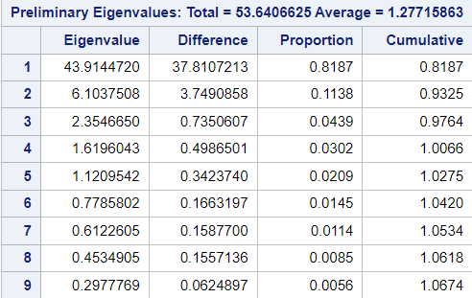
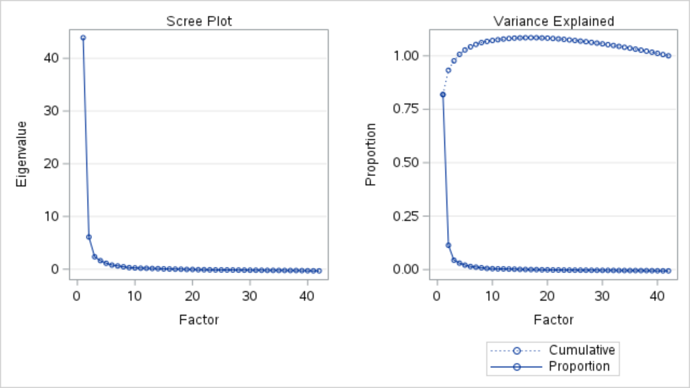
Exploratory Factor Analysis (EFA) -SAS Studio
Exploratory Factor Analysis (EFA) using SAS Studio.
Overall results suggested a 1-factor scale as the eigenvalue at 1 was 43.91.
However, the Eigenvalues met the Kaiser criterion (=>1) at 5 factors with the 3-factor model being 2.35.
Reliability:
Depression = 0.96
Anxiety = 0.91
Stress = 0.93

Slide 15
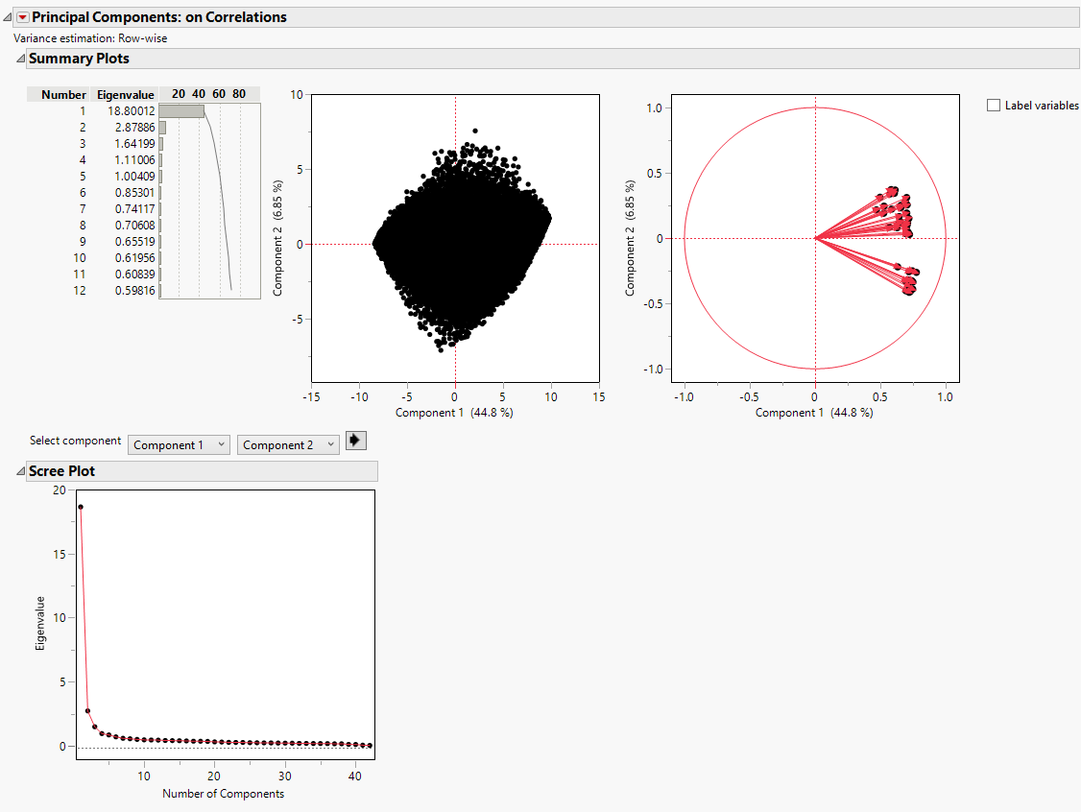
Principal Component Analysis (PCA) - JMP
Principal Component Analysis (PCA) in JMP
Kaiser Criterion suggests a 1-factor model with the eigenvalue at 18.80.
However, a 5-factor model also meets the Kaiser criterion (=>1).
Scree plot
Loading plot: direction of vectors

Slide 16
EFA/PCA
Parkinity & Mcauley (2010) found that reliability for these subscales ranges from .96-.97, .84-.92, and .90-.95 for depression, anxiety, and stress, respectively.
Overall, our EFA and PCA results (e.g., eigenvalues, Scree plot, and loading plot vectors), suggest a 1 factor model.
High correlation between depression, anxiety, and stress (Brown et al., 1997).
For future research, we hope to explore a Parallel Analysis to use resampling methods to determine the best factor model, Item Response Theory (IRT), and Rasch Modeling.
All things considered, we proceeded to conduct further analysis with a 3-factor model, one subscale for depression, anxiety, and stress, respectively.

Slide 17
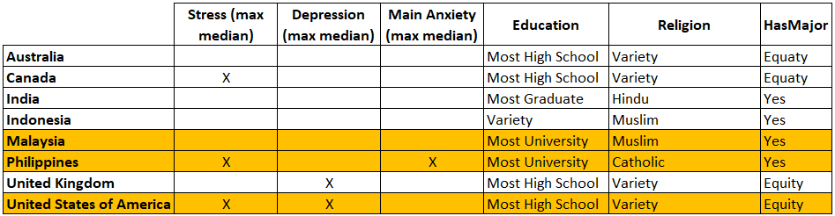
Generalized Regression
Before jumping into the analysis, decided to focus on 3 countries. Different behaviors on the distribution plots were found by country. For that reason, 3 countries with notorious differences will be considered for this analysis.

Slide 18
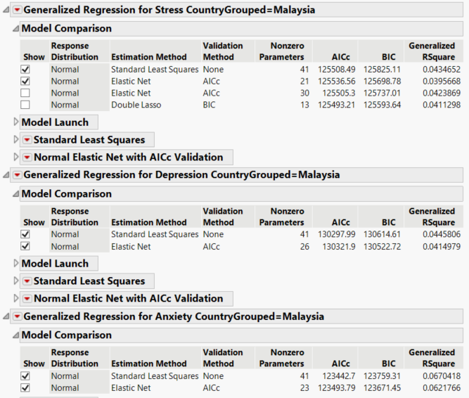
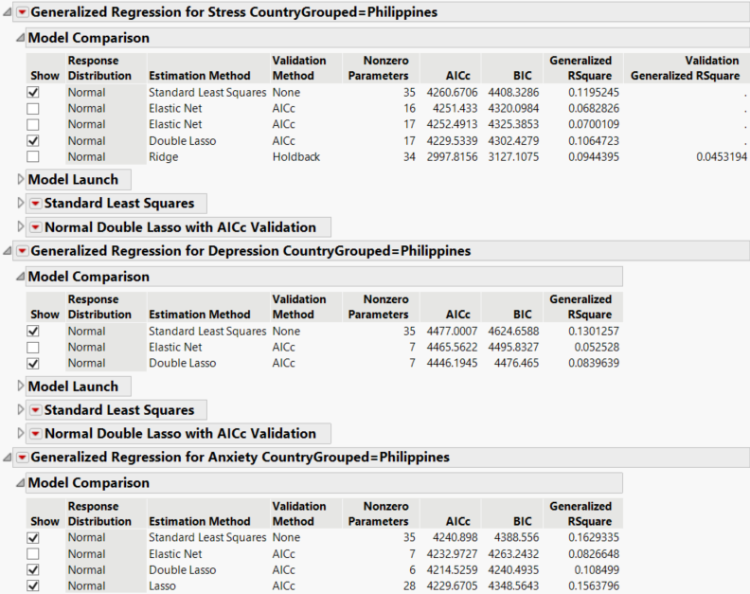
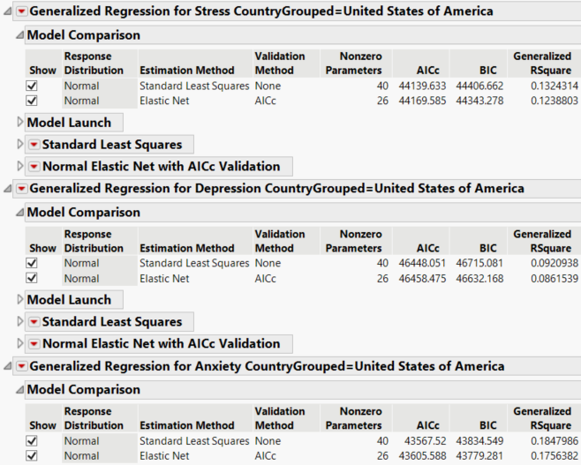
Generalized Regression
Using JMP we ran a generalized regression and tried a diverse of estimation methods for each country. The ones that worked best are:
Malaysia: Elastic Net
Philippines: Double Lasso
United States: Elastic Net
In the following summary, we are going to focus on the best 7 predictors suggested by each region model:

Slide 19
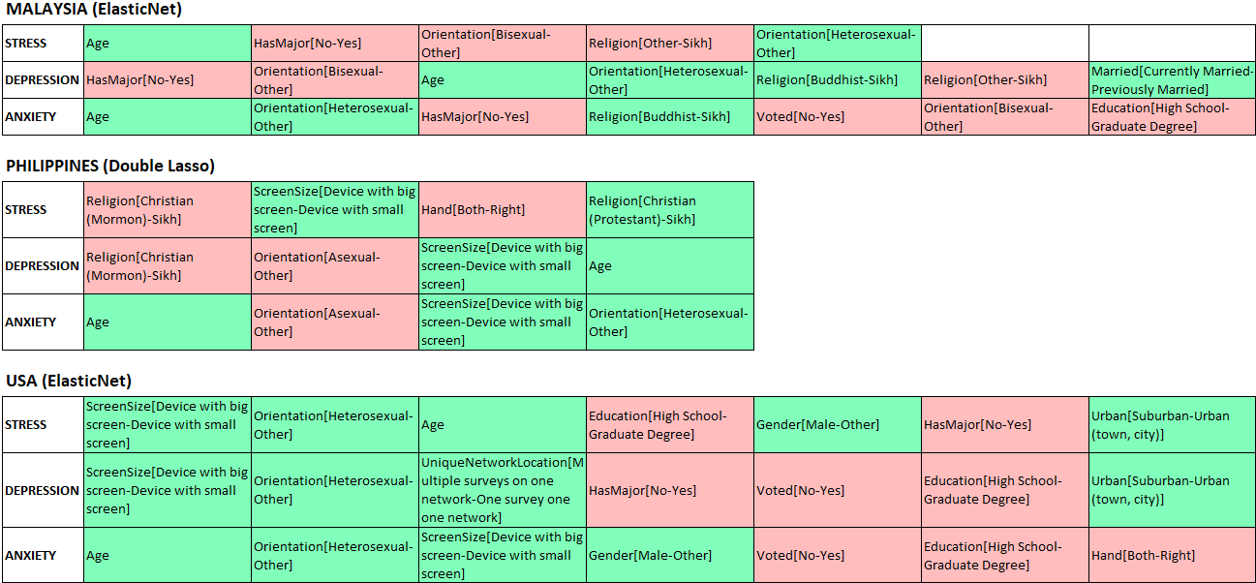
Generalized Regression
Malaysia
Philippines
United States

Slide 20
Generalized Regression
Findings
Age and heterosexuality are frequently estimated as predictors with a positive effect against stress, depression, and anxiety.
In contrast, religion and sexual orientation estimates are negative predictors in Malaysia and the Philippines.
Lower education impacts badly to stress, depression, and anxiety to Malaysians.
Being asexual in the Philippines tends to increase depression and anxiety scores.
Despite almost half of Americans having a major, a lower education level still negatively impacts stress, depression, and anxiety scores.

Slide 21
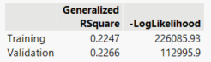
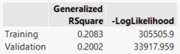
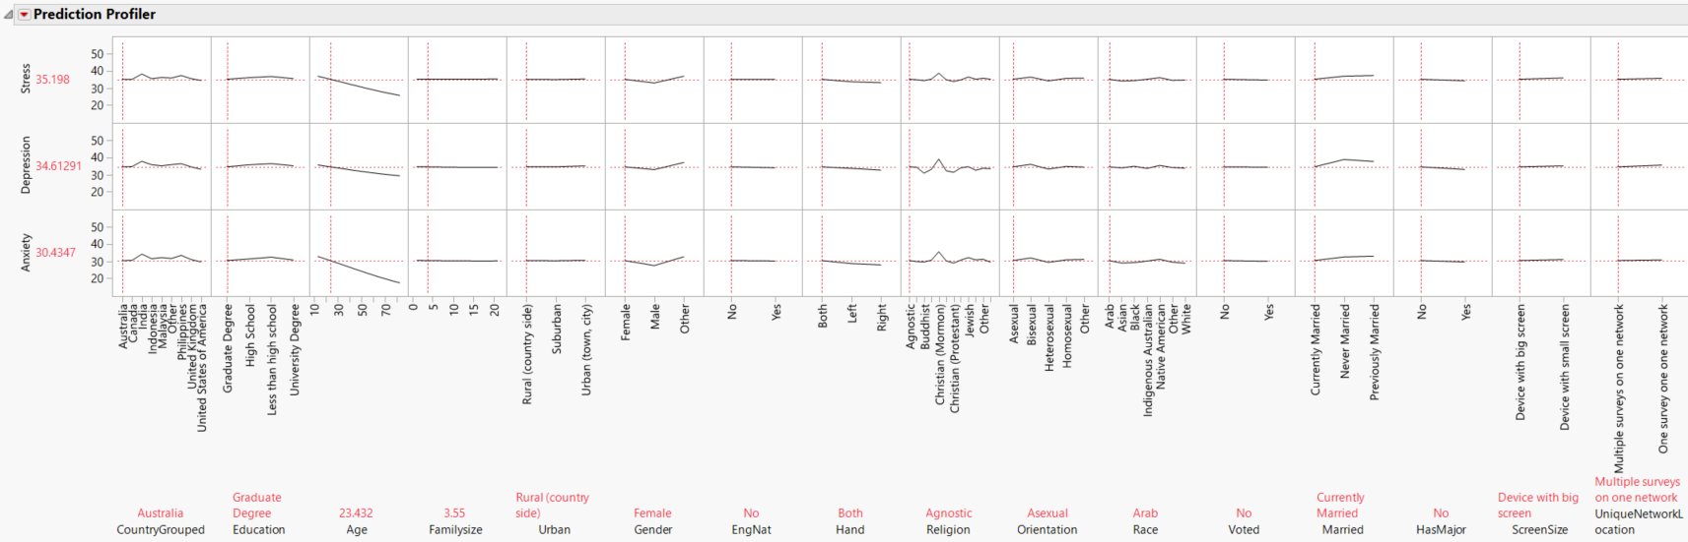
Artificial Neural network
First, an ANN modeling was used considering all the countries. A validation random Holdback and a 10-fold cross validation were tested. The one that slightly has a best RSquare outcome is the Holdback.
Here’s the result…

Slide 22
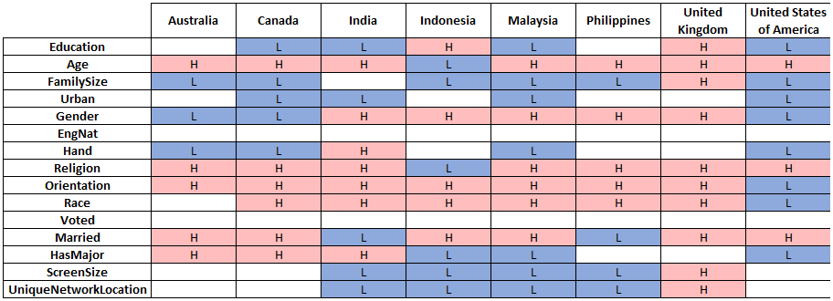
Artificial Neural network
The profiles was used to suggest the impact for each of the predictors by country:
If there’s no impact, the cell is blank.
If the impact is low, the cell shows an L with blue background.
If the impact is high, the cell shows an H with red background.

Slide 23
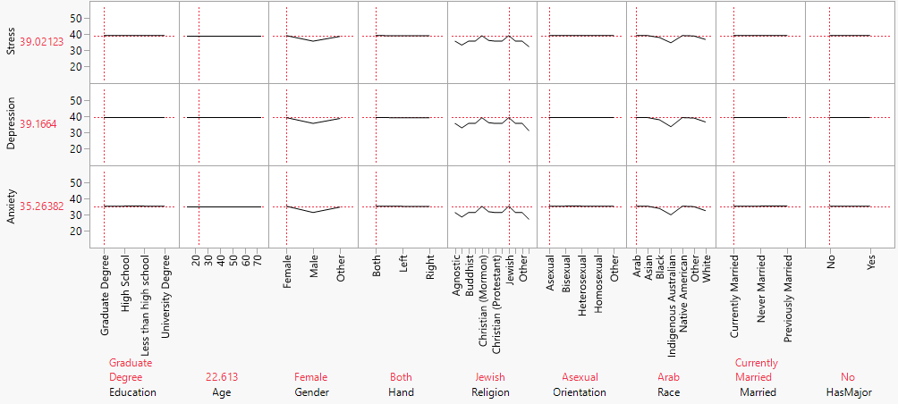
Artificial Neural network
Finally, an ANN modeler was runned with the most influential predictors by the 3 countries selected on the general regression analysis.
Profiler for Malaysia

Slide 24
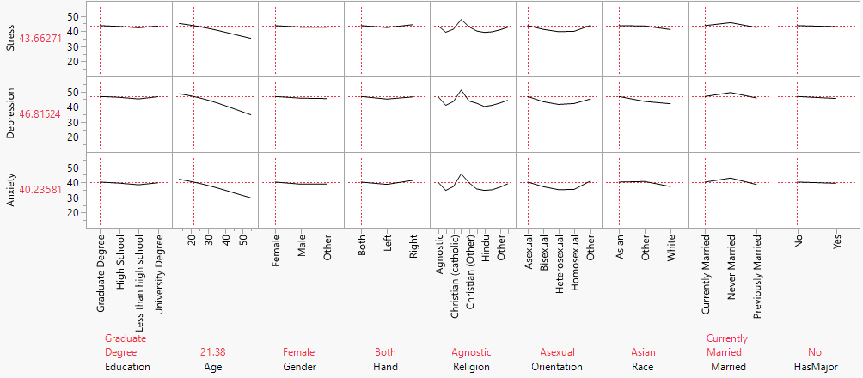
Artificial Neural network
Finally, an ANN modeler was runned with the most influential predictors by the 3 countries selected on the general regression analysis.
Profiler for Philippines

Slide 25
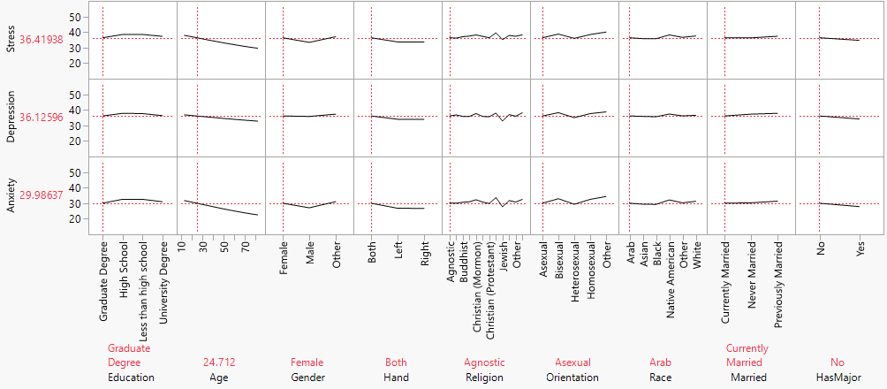
Artificial Neural network
Finally, an ANN modeler was runned with the most influential predictors by the 3 countries selected on the general regression analysis.
Profiler for United States

Slide 26
Artificial Neural network
Malaysia findings:
Gender: Males have lower scores.
Religion: Sikhs and Atheists have lower scores. Christian Mormon and Jewish have the highest. Muslim is in the middle, which means good and bad DASS scores can be obtained as Muslim, despite the fact it’s the most popular religion. Being Jewish affects non-male respondents. Religion impacts the patterns of the race predictor.
Race: Indigenous Australians and white have lower scores.
Age is not an influential predictor here.
Philippines findings:
Age: Higher age lowers DASS scores.
Religion: Christian Mormons, agnostics, and others have higher scores.
Orientation: Asexuals and others have higher scores.
People that never married have higher scores.
United States of America findings:
Age: Higher age lowers scores.
Gender: Males have lower scores, except in depression.
Orientation: Asexuals and heterosexuals have lower scores.
Lower education increases scores.

Slide 27
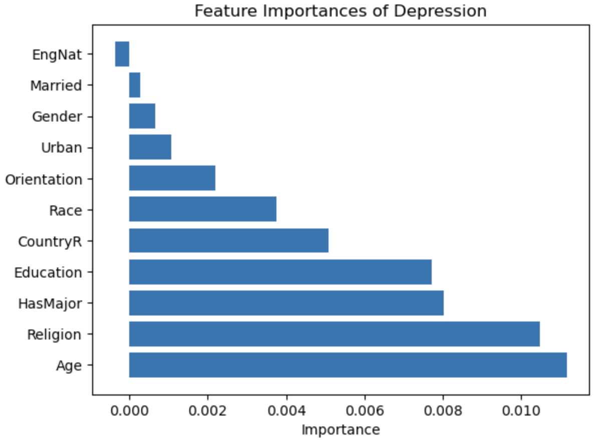
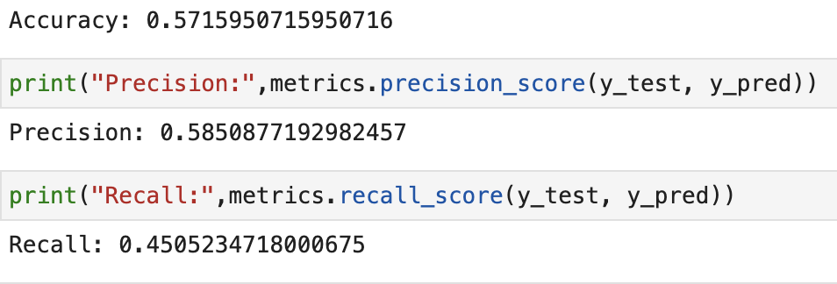
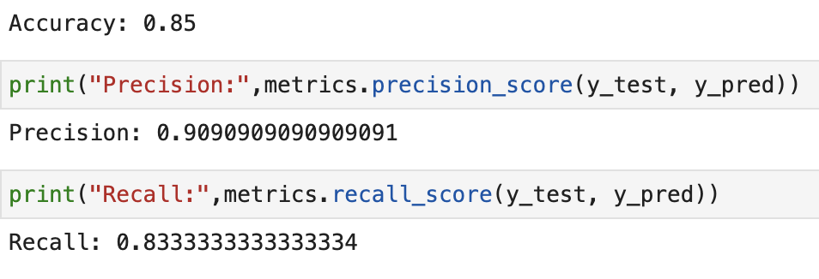
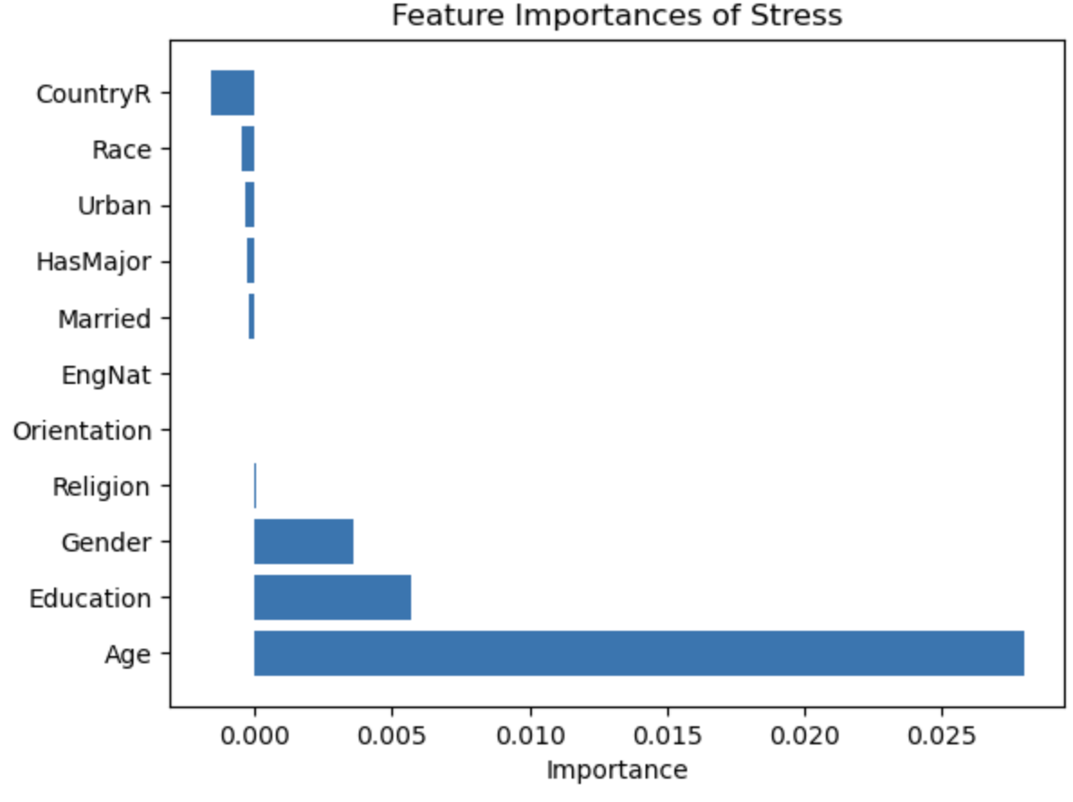
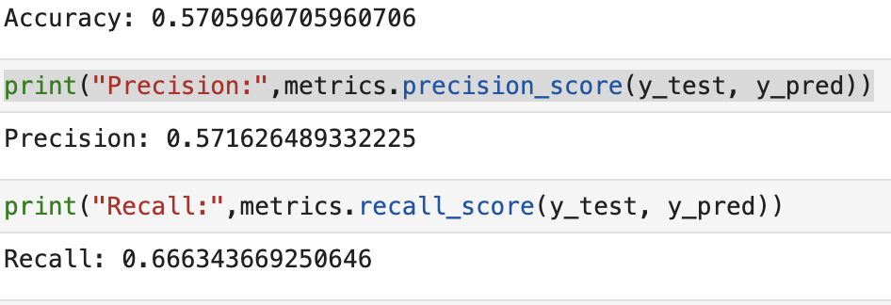
Support Vector Machine (Poly Kernel)
Depression
PP Artificial Neural network
SVM poly kernel was a better model than the linear model for depression, anxiety, and stress prediction
For depression, age was the most important feature, followed by religion and having a major
For stress, age was the most important feature, followed by education
Anxiety
Stress
Notes:
We wanted to try to understand our data more and look for any consitencies, patterns, or trends within our data, so we decided to run a model comparison to pick the best model between a poly and kernel in SVM. If we take a look at the Accuracy, precision scores they show that the model is quite robust. After identifying what the best model is we wanted drill down and understand what is happening and what are important features and what are the high scoring predictors. Looking at the important features of DAS we can see that it corresponds to what Leo mentioned in the previous slide with regards of Age and sexuality being important predictors with respect to Malaysia however to be mindful Malaysia did make up a larger distribution of the data

Slide 28
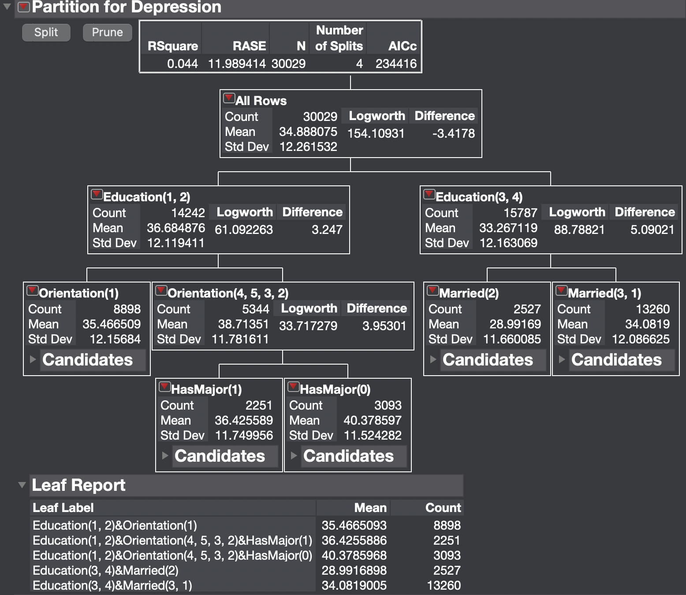
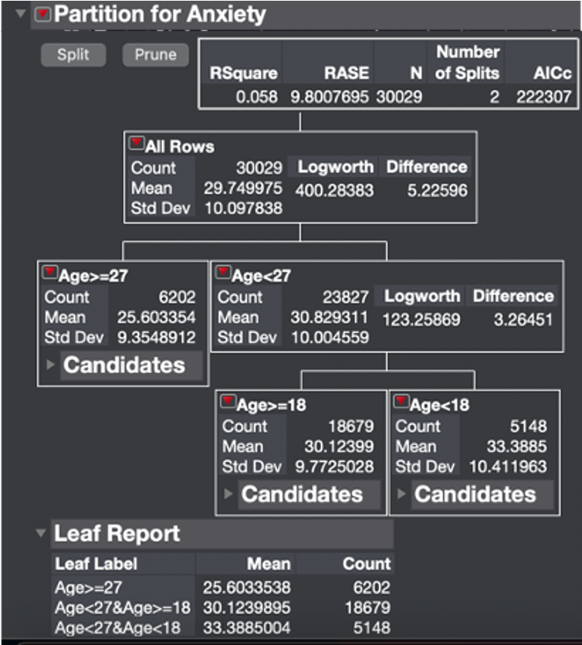
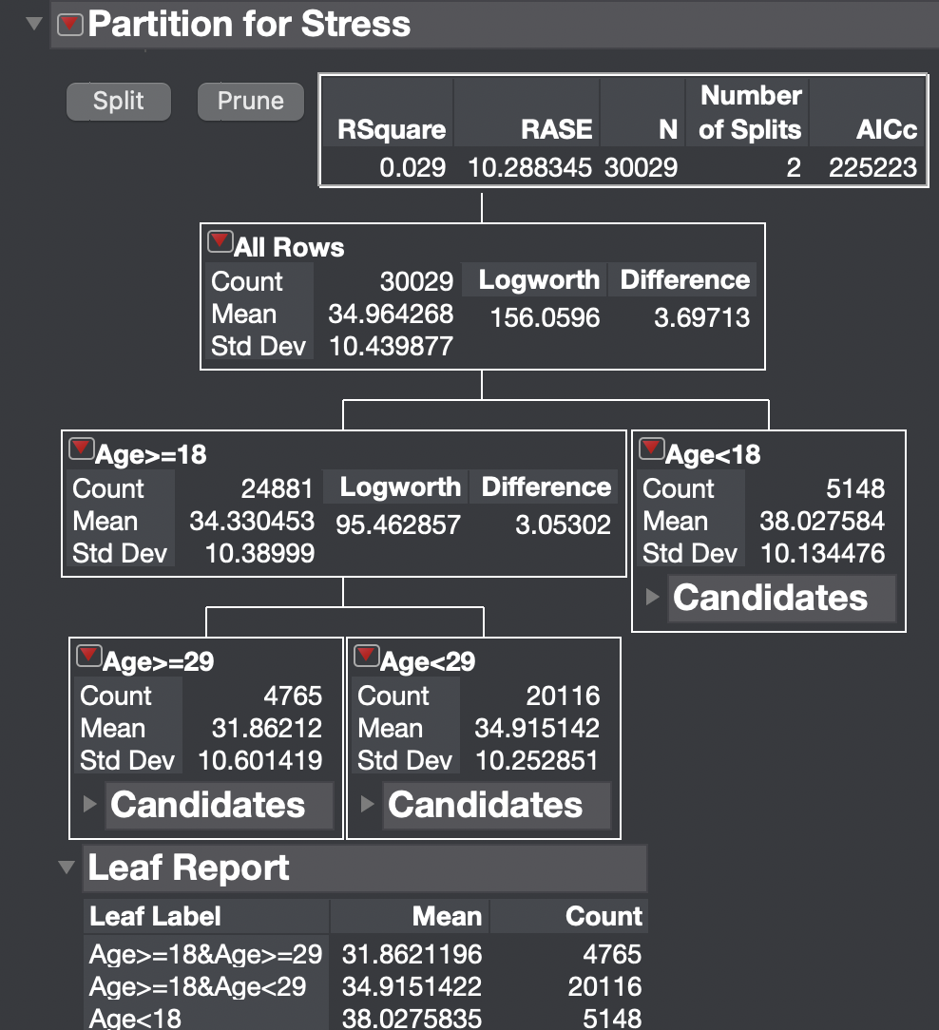
Decision Tree & Leaf Report
Education (Less than HS, HS) and Orientation (H) were the two most important factors in predicting depression
Age is the most important factor in predicting anxiety
Age was found to be an important predictor of stress
Notes:
Continuing where I left off with the SVM analysis I wanted to explore the data more and see if there are a consistency across the models as far as age as a reappearing feature or predictor if you will so we decided to proceed with decision tree analysis
Depression = Individuals with less education and heterosexual orientation are more likely to experience depression than those with higher education levels or different sexual orientations although thinking back to yje data distribution that Leo showed us in the previous slide we want to be mindful that a large distribution of the data contained individuals who identified as hetrosexual
Anxiety = Older people are more likely to experience anxiety. The average anxiety score for people between the ages of 18 and 27 was 30.12, which is lower than the average score of 33.39 for people who are below the age of 27 and 18 or older
Stress = Individuals with ages greater than or equal to 29 had a lower mean stress score of 31.86. individuals aged 29 or older showing a significantly lower mean stress score than younger adults which also collaborates with leo AN in US

Slide 29
Previous Study using Machine Learning
To investigate the relationship between emotional intelligence and mental health outcomes Priya et al., (2020), analyzed data from 255 Egyptian nursing students using the Depression Anxiety Stress Scales (DASS) and five machine learning algorithms, two of which were Decision Tree and Support Vector Machine
The study also found that the use of SVM and Random Forest techniques led to more precise models for predicting stress, anxiety, and depression levels among nursing students however, Random Forest was the most accurate algorithm in predicting
Overall, the study highlights the benefits of machine learning in uncovering complex relationships and patterns that may be missed by traditional statistical methods

Slide 30
K-Mean Cluster Analysis (JMP)
Clustering methods attempt to create groups based on similar responses.
Tran et al., 2019 collected 787 responses from registered nurses in a hospital in Vietnam using the DASS-21 then performed a two-step cluster analysis.
They looked at: stress, anxiety, depression, age, and number of years working in the hospital.
From their analysis they obtained three clusters:
Cluster 1 reported:
high prevalence of mental health problems and limited job control.
Cluster 2 reported:
lower prevalence and less severity of mental health problems, older age, permanent employment, and longer years working.
Cluster 3 reported:
the lowest prevalence of mental health problems, were younger, and had better physical health.
Notes:
<< BRIAN READS, CHARLENE PRESENTS SCREEN >>

Slide 31
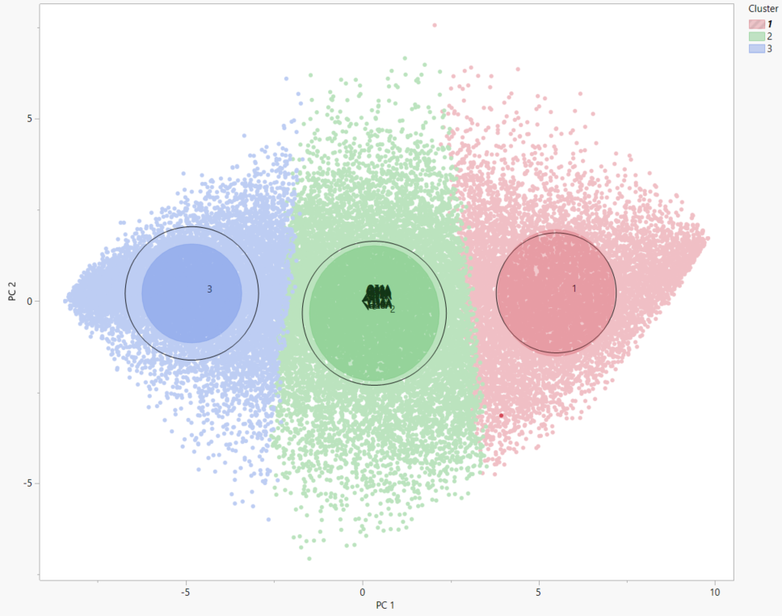
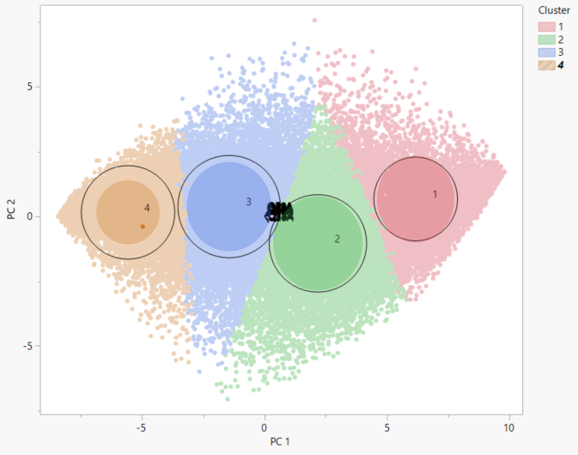
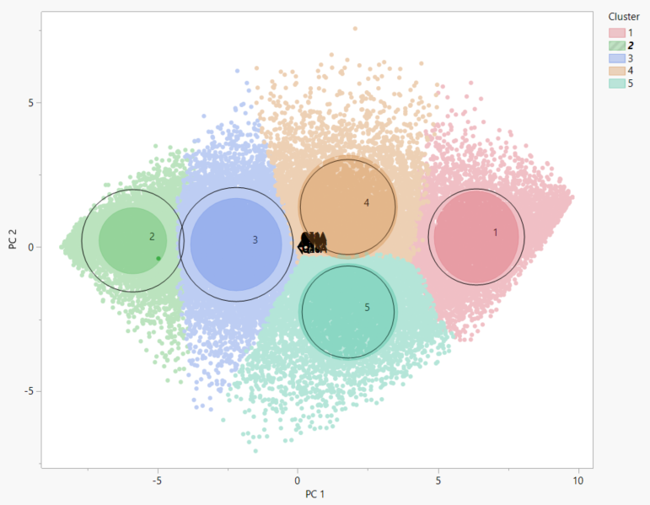
K-Mean Cluster Analysis (JMP)
How many clusters is best?
3 vs 4 vs 5 vs 10?
Visually 3 clusters seemed best
Eigenvalue 18.81
Notes:
< CLICK > I ran the K-Mean Cluster Analysis. I tried to determine how many clusters was ideal.
I tried 3 to 10 clusters and ultimately determined that 3-5 is best with possibly 3 to 4 being better.
The 3 - Cluster Eigenvalue came to be 18.81 which meets the Kaiser criterion.
Here is what the 3 - Cluster looks like. < CLICK > and the 4-cluster < CLICK > and the 5-cluster < CLICK >.
ALL look pretty well-grouped.
To test my hypothesis, I ran an Elbow Analysis. < NEXT SLIDE >

Slide 32
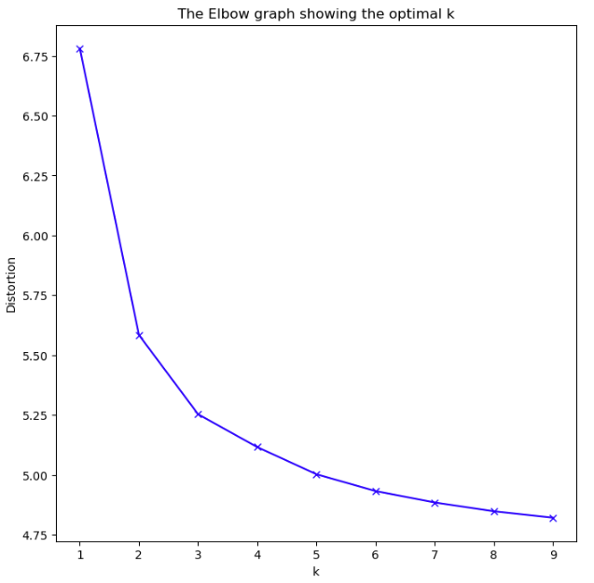
Elbow Analysis (Python)
Notes:
< CLICK > I ran the Elbow analysis using a python script given by Dr Yu and then modified for iterations for the 42-items in the DASS scale.
< Use mouse to point to elbow > When looking here, it looks like the elbow or bend is at a 3
< CLICK > Here is what the 3-cluster looks like again.

Slide 33
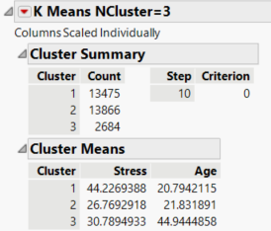
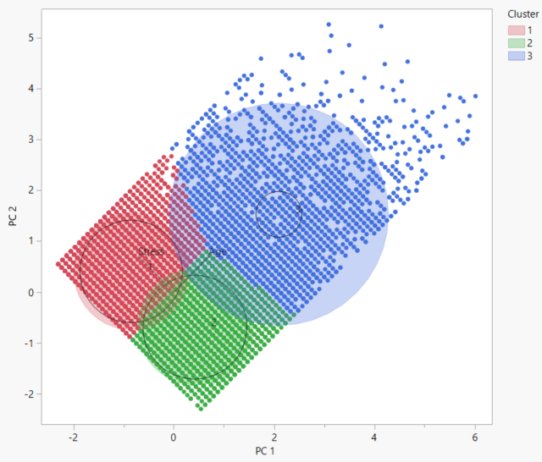

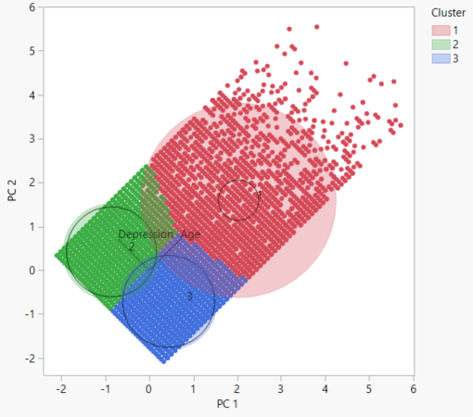
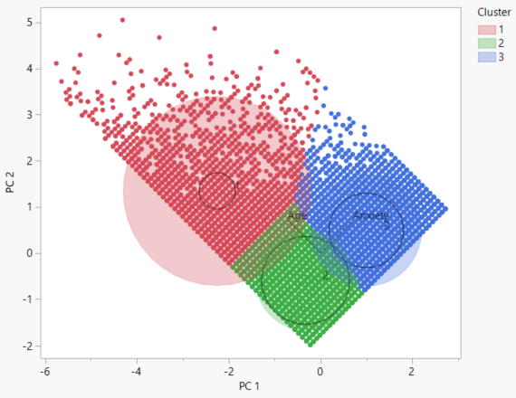
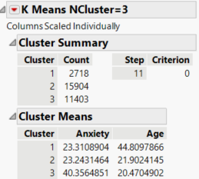
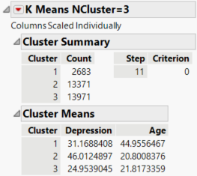
K-Means Cluster Analysis
Eigenvalues for:
Stress 1.16
Depression 1.13
Anxiety 1.24
Stress, Depression, Anxiety
Age
When it comes to anxiety and depression, the mean age group of 21 is highest.
Followed closely by the 45 mean age group.
However, when it comes to anxiety, the groups with the mean age of 45 and 22 are remarkably less anxious than the cluster with the mean age of 20.
Notes:
< CLICK , CLICK > For the actual k-means cluster analysis, I was interested in the three subscales in relation to age.
< CLICK >
For Stress - < CLICK >
Cluster 1 has Highest level of stress
Mean age is 21
Mean rate is 44
Followed by Cluster 3 next highest rate of stress, the cluster is also more disbursed.
Mean age is 45
Mean rate is 31
Cluster 2 has the lowest rate in stress
Mean age is 22
Mean rate is 27
Eigenvalue of 1.16
For Depression < CLICK >
Cluster 2 has highest level of depression
Mean age is 21
Mean rate is 46
Followed by Cluster 1, which this cluster is disbursed
Mean age is 45
Mean rate is 31
Cluster 3 has the lowest level of depression
Mean age is 22
Mean rate is 25
Eigenvalue 1.13
For Anxiety < CLICK >
Cluster 3 has the highest level of anxiety
Mean age is 20
Mean rate is 40
Closely tied is Cluster 1 and 2
Cluster 1 mean age is 45, mean rate is 23.31 it is also the more disbursed cluster
Cluster 2 mean age is 22, mean rate is 23.24
Eigenvalue 1.24 -> ALL 3 SUBSCALES MEET THE KAISER CRITERION.
< CLICK >
CONCLUSION: When it comes to anxiety and depression < CLICK > it looks like the cluster with the mean age group of 21 is highest.
< CLICK > Followed closely by the 45 mean age group.
However, when it comes to anxiety, < CLICK > the groups with the mean age of 45 and 22, respectively are remarkably less anxious than the cluster with the mean age of 20. < CLICK >
SO….moral of the story is… < CLICK >
DON’T WORRY BE HAPPY, life gets better as you get older. < CLICK > < NEXT SLIDE >

Slide 34
DASS Metrics
Conjoined Twins: Depression and Anxiety
Most frequently co-occurring
Difficult to differentiate the overlap between the two.
Challenging for researchers and clinicians
Objective: to cover the full range of core symptoms yet provide maximum distinction (Yeung, et al, 2020)
Essential Value: to clarify the locus of emotional disturbance (Lovibond & Lovibond, 2022)
Essential Function: to assess the severity of the core symptoms of depression, anxiety and stress.
Tripartite model with 3 dimensions (Scholten, et al, 2017)
Uniquely developed for its time.
Bootstrapping strategies (Yeung, et al, 2020)
Stress subscale came later.
Discussion
Most common analyses run (Yeung, Scholten, et al)
Single-group CFA
Multi-group CFA (Scholten, et al)
Likelihood Ratio Test (chi-squared) for evaluating model fit (Scholten )
Subsidized with Monte Carlo to compensate for sensitivity to significance
EFAs, PCAs, CFAs
1 to 3-factor analyses
Latent Factor Mean Comparisons
Notes:
< CLICK > In the field of psychology, < CLICK >
Depression and anxiety are two of the most co-occurring disorders
< CLICK > historically it has been difficult to empirically distinguish between the two.
< CLICK > There are countless studies that have attempted to distinguish the overlap between the two and it has been challenging for researchers and clinicians alike.
< CLICK >
DASS Metrics have been rigorously tested. < CLICK >
The key objective was to create a scale that would cover the full range of core symptoms of depression and anxiety yet provide maximum distinction
< CLICK > The essential value of DASS in a clinical setting is to CLARIFY the locus of emotional disturbance, as part of the broader task of clinical assessment.
< CLICK > The essential function of the DASS is to assess the severity of the core symptoms of depression, anxiety and stress.
< CLICK > DASS Scale was developed by Lovibond and Lovibond as a tripartite model of anxiety and depression with 3 dimensions
Just a bit of historical info: < CLICK > How this scale came about was unique for its time, according to Yeung et alia.
< CLICK > DASS was created with scientifically driven bootstrapping strategies, a resampling technique to test the significance of the difference between latent factors of depression and anxiety.
< CLICK > The STRESS subscale actually came about after developing depression and anxiety subscales.
Some common analyses that were utilized in the different studies reviewed by Yeung, Scholten, and others were:
Single-group CFA
Multi-group CFA (Scholten, et al)
Likelihood Ratio Test (chi-squared) for evaluating model fit (Scholten )
Subsidized with Monte Carlo to compensate for sensitivity to significance
EFAs, PCAs, CFAs
1 to 3-factor analyses
Latent Factor Mean Comparisons

Slide 35
Conclusion:
While our EFA and PCA suggested 1 factor model based off the Kaiser Criterion, Scree, and Loading Plot, further analysis were conducted using a three factor model.
General regression analysis and ANN methods suggest that different countries impacts on the influence of the predictor variables. Most of the plots include Age, sexual orientation, religion and education level as influential predictors.
SVM poly kernel out-preformed linear models in predicting DASS levels
Decision tree analysis showed education (Less than HS, HS), and sex orientation (H) were critical predictors of depression, and age was the most important factor for predicting anxiety and stress
K-Means & Possible implications for future studies
Notes:
CHARLENE:
Going back to the DASS scale and 16-Validity Check Items
Flort or florted is actually a slang word. It means unintentional flirting.
Verdid - sounds too similar to verdad in Spanish.
And according to The Free Dictionary.com VERDIT is synonymous to VERDICT.
Future investigators may want to come up with different non-words.
Although there are not many DASS studies that have used K-Means or cluster analyses in general, it’s a great visual to see some of the correlations between symptomatology and other variables such as age, gender, etc. It’s also helpful to see how the groups segment and what each cluster share in common and give insight into planning future studies.

Slide 36
References
Beiter, R., Nash, R., McCrady, M., Rhoades, D., Linscomb, M., Clarahan, M., & Sammut, S. (2015). The prevalence and correlates of depression, anxiety, and stress in a sample of college students. Journal of Affective Disorders, 173, 90-96. https://doi.org/10.1016/j.jad.2014.10.054
Brown, T. A., Chorpita, B. F., Korotitsch, W., & Barlow, D. H. (1997). Psychometric properties of the Depression Anxiety Stress Scales (DASS) in clinical samples. Behaviour Research and Therapy, 35(1), 79-89. https://doi.org/10.1016/S0005-7967(96)00068-X
Gloster, A. T., Rhoades, H. M., Novy, D., Klotsche, J., Senior, A., Kunik, M., Wilson, N., & Stanley, M. A. (2008). Psychometric properties of the Depression Anxiety and Stress Scale-21 in older primary care patients. Journal of affective disorders, 110(3), 248–259. https://doi.org/10.1016/j.jad.2008.01.023
Holden, C. (2000). Global survey examines impact of depression. Science, 288(5463), 39-40. https://doi.org/10.1126/science.288.5463.39
Lovibond, P. F. (2022, June 22). Overview of the DASS and its Uses. Retrieved from http://www2.psy.unsw.edu.au/dass/over.htm
Lovibond, S.H. & Lovibond, P.F. (1995). Manual for the Depression Anxiety Stress Scales. (2nd. Ed.) Sydney: Psychology Foundation.
Parkitny, L., & McAuley, J. (2010). The depression anxiety stress scale (DASS). Journal of Physiotherapy, 56(3), 204. DOI:10.1016/S1836-9553(10)70030-8
Priya, A., Garg, S., & Tigga, N. P. (2020). Predicting anxiety, depression and stress in modern life using machine learning algorithms. Procedia Computer Science, 167, 1258-1267. https://doi.org/10.1016/j.procs.2020.03.442
Scholten, S., Velten, J., Bieda, A., Zhang, X. C., & Margraf, J. (2017). Testing measurement invariance of the Depression, Anxiety, and Stress Scales (DASS-21) across four countries. Psychological Assessment, 29(11), 1376–1390. https://doi.org/10.1037/pas0000440.supp (Supplemental)
Tran, T. T. T., Nguyen, N. B., Luong, M. A., Bui, T. H. A., Phan, T. D., Tran, V. O., ... & Nguyen, T. Q. (2019). Stress, anxiety and depression in clinical nurses in Vietnam: a cross-sectional survey and cluster analysis. International Journal of Mental Health Systems, 13, 1-11. https://doi.org/10.1186/s13033-018-0257-4
Van Ameringen, M., Mancini, C., & Farvolden, P. (2003). The impact of anxiety disorders on educational achievement. Journal of anxiety disorders, 17(5), 561-571. https://doi.org/10.1016/S0887-6185(02)00228-1
Yeung, A. Y., Yuliawati, L., & Cheung, S. (2020). A systematic review and meta-analytic factor analysis of the Depression Anxiety Stress Scales. Clinical Psychology: Science and Practice, 27(4). https://doi.org/10.1037/h0101782.supp (Supplemental)
Yaribeygi, H., Panahi, Y., Sahraei, H., Johnston, T.P., Sahebkar, A. (2017) The impact of stress on body function: A review. EXCLI Journal, 16, 1057-1072. doi: 10.17179/excli2017-480.

